Slide 1
Madrid Analysis
Power BI Project
Name : APARNA SHRIVASTAVA
Role: Data Analyst Project
Tools Used:
Power BI
Power Query
DAX

Slide 2
Project Objective
The objective of this project is to analyze Madrid real estate market trends using Power BI and identify:
Property pricing trends
Impact of luxury features
Investment insights
Market segmentation opportunities

Slide 3
Dataset Overview
The project uses a Madrid housing dataset containing approximately 22,000 property listings.
The dataset includes both numerical and categorical variables, allowing comprehensive market analysis.
Important numerical attributes include:
Built Area
Buy Price
Loan Interest Rate
Important categorical attributes include:
House Type
Pool Availability
Garden Availability
Exterior Status
New Development Status
Region
The dataset provides sufficient information to analyze both pricing behavior and investment potential.

Slide 4




Avg Price =
AVERAGE(houses_Madrid[buy_price])
Avg Price per SqM =
DIVIDE(AVERAGE(houses_Madrid[buy_price]),
AVERAGE(houses_Madrid[sq_mt_built]))
Key
Measures
DAX
Investment Score =
AVERAGE(houses_Madrid[sq_mt_built]) /
AVERAGE(houses_Madrid[loan_int_rate])
Total Listings = COUNT(houses_Madrid[id])

Slide 5
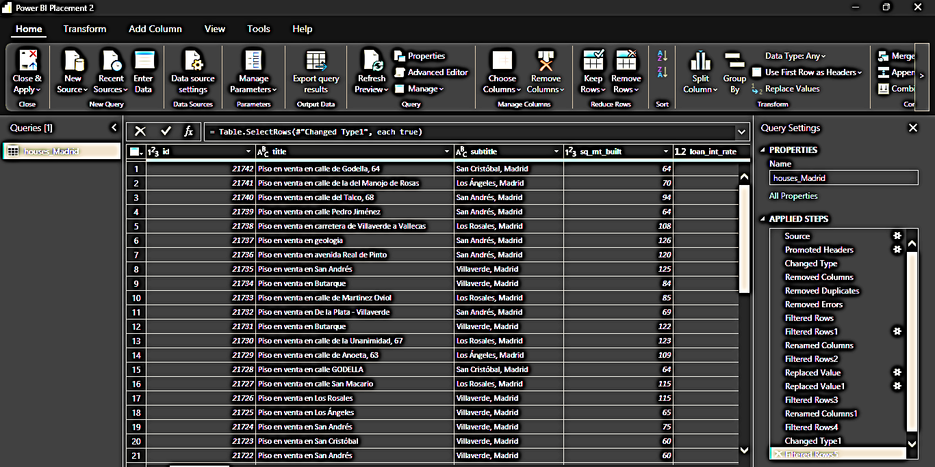
Data Cleaning and Transformation
The Madrid housing dataset containing more than 22,000 listings was cleaned and transformed before visualization.
Duplicate property records were identified using unique property IDs and duplicate indicators.
Data types for price, built area and interest rate fields were validated to prevent aggregation errors.
Numeric conversion issues present in certain records were corrected using Power Query transformations.
Additional DAX measures such as Average Price, Average Price per SqM and Investment Score were created to support analysis.

Slide 6
Tools Used in the Project
Tool | Purpose
Power BI :- | Dashboard creation
Power Query :- | Data cleaning
DAX :- | KPI calculations
CSV Dataset :- | Data source

Slide 7
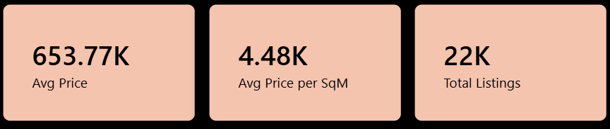
Madrid Market KPI Analysis
The average property price of €653.77K indicates that Madrid represents a premium real estate market with strong demand for high-value properties.
An average price per square meter of €4.48K highlights the significant variation in property valuation based on location and amenities.
The analysis is based on more than 22,000 listings, improving the reliability and representativeness of the findings.

Slide 8

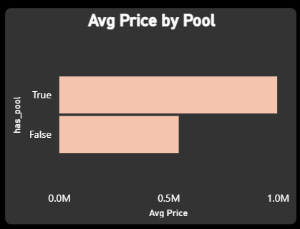

Pool Feature Price Analysis
Properties with swimming pools show an average price of approximately €878.87K.
Properties without pools average around €587.87K.
Pool availability increases average prices by approximately 49.5%.
Buyers are willing to pay premium prices for pool amenities.

Slide 9


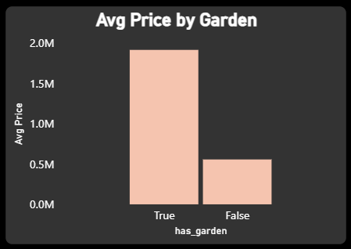

Garden Feature Price Analysis
Properties with gardens average nearly €1.90M compared to €0.70M for properties without gardens.
Garden availability contributes to approximately 171% higher valuation.
Garden availability increases property attractiveness.
Premium outdoor amenities positively influence market value.

Slide 10
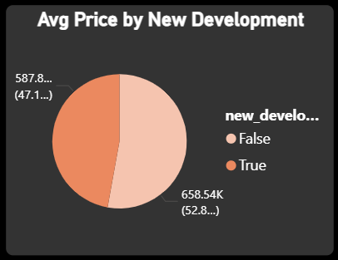
New Development Property Analysis
Newly developed properties average approximately €658.54K.
Existing developments average approximately €587.87K.
New developments command approximately 12% higher prices.
Modern infrastructure increases buyer demand.
New development projects offer strong investment potential.

Slide 11
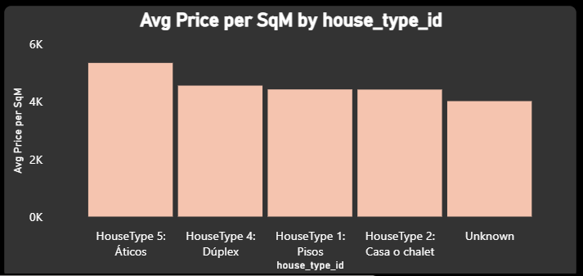
House Type Market Segmentation
Significant variation exists in pricing across property categories.
Áticos and Duplex properties demonstrate premium market positioning.
Casa o Chalet properties provide larger living areas and attract long term investors.
Different property categories target different customer groups and investment strategies.

Slide 12
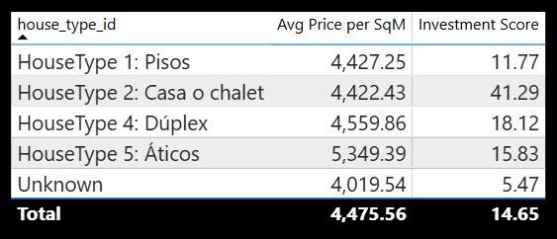
Investment Opportunity Analysis
Casa o Chalet properties generate an investment score approximately 2.3 times higher than Duplex properties.
Premium properties provide higher selling prices but not always the highest investment efficiency.
High square meter properties with lower loan interest rates provide better ROI
Investment score helps identify profitable property categories
Investors can use these insights for decision making

Slide 13
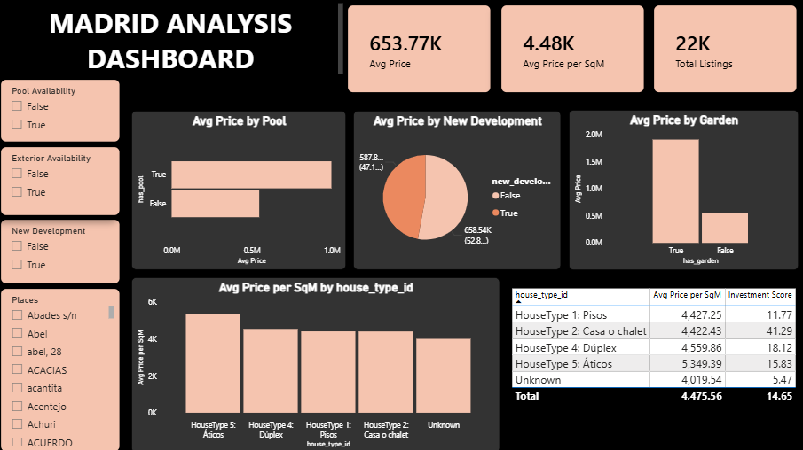
Interactive Dashboard

Slide 14
Business Recommendations
Investors should focus on premium property segments such as Áticos and Duplex
Use price per square meter alongside property price for valuation decisions.
Properties with luxury amenities offer higher market value
New development projects have strong pricing potential
Interactive dashboards help stakeholders make data-driven decisions

Slide 15
Conclusion:
The Madrid Real Estate Analysis project successfully transformed raw housing data into actionable business insights using Power BI.
The analysis identified key pricing drivers, premium amenities and profitable investment opportunities.
Property features such as pools, gardens and new developments demonstrated significant influence on market valuation.
Market segmentation and investment scoring enabled identification of high-potential property categories.
The project demonstrated practical capabilities in data cleaning, modelling, visualization and business storytelling.

Slide 16
THANK YOU

